Slide 1
Hack 4 Good November 2016
Notes:
Thank you David and the team at Microsoft
My name is Amy Whalley, Deputy CEO from Australian Network on Disability
We are very excited to be part of the Hack4Good with Microsoft. Accessible technology holds great opportunity, choice and participation for people with disability within the community and endless possibilities for businesses. Accessibility ICT opens the door to services, employment and connectivity for everyone.
Background
The Australian Network on Disability is a member based, not-for-profit organisation, which was established in the year 2000.
Our members are large private and public sector organisations from across Australia. We have over 175 members in our network, and the membership base employs 11% of the working population in Australia.
By working with employers, our vision is to create a disability confident Australia.
We provide expert advice and services relating to the access and inclusion for people with disability in all areas of businesses. We believe in addressing and changing the Behaviours Attitude Systems and Knowledge of employers to become more disability confident and facilitate inclusion of people with disability into workplaces.
Our work is diverse and includes:
Consultancy, such a strategy and policy and procedure development, Access and Inclusion action plans and workplace adjustment processes
Providing workforce learning and development
Publications and resources
Internships and mentoring programs
For my presentation, I’m going to provide you with some more context and awareness of disability in Australia, give details and feedback we have received from our members and the community on barriers people with disability may face and how potentially they could be removed by the use of technology.
The presentation slides and notes, and links to other resources will be available on the Hack4Good hub page

Slide 2
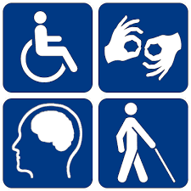
Australian Population
1 in 3
People have a disability or are close to someone who does
Nearly one third (31%) of complaints lodged with AHRC are against businesses and related to disability
18.5%
of the population has disability, that’s over 4.3 million Australians
Notes:
Over 4 million Australians have a disability. That's 1 in 5 people (Source: ABS 2015)
Disability Discrimination Act 1992
Employment
Education
Provision of goods, services and facilities
Access to premises
Accommodation
Sport

Slide 3
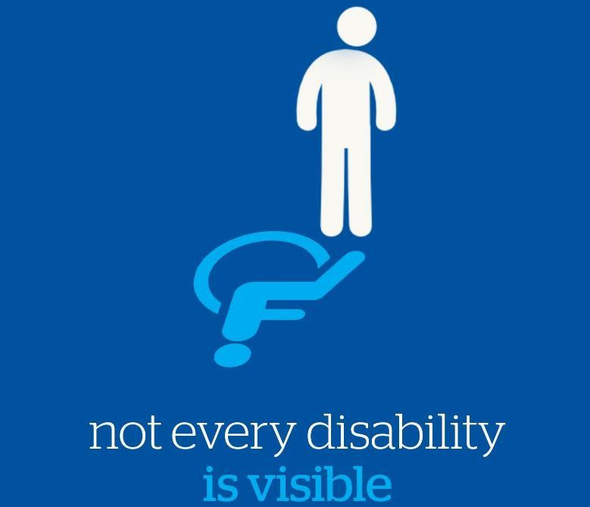
Disability is diverse and can change over time
Notes:
The majority of Australian’s are not born with disability, they acquire disability as they age and as we know Australia’s population is ageing.
Disability is often invisible
It may be permanent or temporary
3.4 million (15%) Australians have a physical disability
1 in 6 Australians are affected by hearing loss.
There are approximately 30,000 Auslan users
Vision Australia estimates there are currently 357,000 people in Australia who are blind or have low vision
10% of the population has dyslexia. That’s more than two million Australians
Around 668,100 (3%) Australians have intellectual and/or developmental disorders
45% of the population will experience a mental health disorder during their lifetime

Slide 4
Medical Model
Medical Condition or Impairment
Locomotion
Dexterity
Reach and stretch
Communication
Thinking
Vision
Hearing
Notes:
Two major conceptual models of disability have been proposed. The medical model views disability as a feature of the person, directly caused by disease, trauma or other health condition, which requires medical care provided in the form of individual treatment by professionals.
Disability, on this model, calls for medical or other treatment or intervention, to 'correct' the problem with the individual.

Slide 5
Social Model
Potential Barriers
Attitude
Digital access
Path of travel
Product development
Information
Physical access
Notes:
The social model of disability, on the other hand, sees disability as a socially created problem and not at all an attribute of an individual.
On the social model, disability demands a political response, since the problem is created by an unaccommodating physical environment brought about by attitudes and other features of the social environment.

Slide 6
Participation
Medical Condition or Impairment
Potential Barriers
Locomotion
Attitude
Dexterity
Ability
Digital access
Reach and stretch
Level of Participation
Path of travel
Communication
Product development
Thinking
Vision
Disability
Information
Hearing
Physical access
Notes:
On their own, neither model is adequate, although both are partially valid.
Disability is always an interaction between features of the person and features of the overall context in which the person lives, but some aspects of disability are almost entirely internal to the person, while another aspect is almost entirely external.

Slide 7
Definition
“Persons with disabilities include those who have long term physical, mental, intellectual or sensory impairments which, in interaction with various barriers, may hinder their full and effective participation in society on an equal basis with others”
United Nations Convention on the Rights of Persons with Disabilities
Notes:
“Persons with disabilities include those who have long term physical, mental, intellectual or sensory impairments which, in interaction with various barriers, may hinder their full and effective participation in society on an equal basis with others”

Slide 8
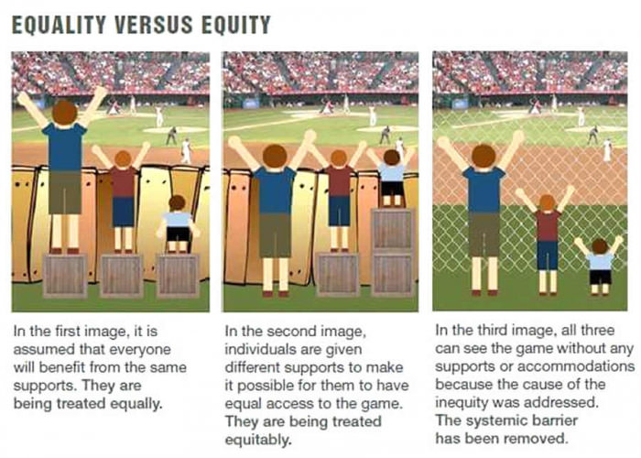
Rights

Slide 9

Notes:
AND asked the community / people with disability to share with us their ideas about how technology could potentially help remove barriers in their day-to-day lives.
We had a number of responses with ideas and issues raised relating to accesses information, getting around in the community, accessing services, payment options, alternate formats for information, attitudes, processes and employment.
People who responded to the survey had various impairments and barriers.
Some people had low vision or blind, mental illnesses (such as anxiety), hearing impairment or Deaf, Autism, Acquired brain injury, mobility impairment, Wheelchair users, Learning disability, Intellectual disability, Deafblind

Slide 10
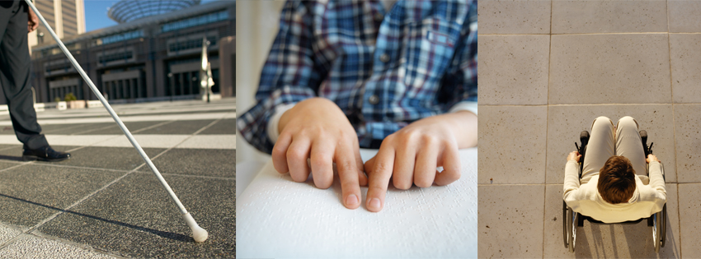
Notes:
There are many devices, assistive technology, pieces of equipment that help remove barriers and support people with disability to participate in the community. But is it enough? Where can technology take us and are there groups of people not being considered when it comes to the development of new ideas and platforms.
Much of the feedback talked about the benefits of the smartphone, and the increased opportunities it provides, however challenges around using multiple technology solutions /platforms and the financial accessibility of products can still be limiting
Lots of the feedback include barriers with way finding, gaining information and dignified access to goods and services
For this project, we have selected a handful of possible barriers / issues that people have faced for you to consider and potential find that all important solution.
Please do not consider this list the only options and areas to consider.

Slide 11
Technology’s role in accessing goods and services
How can a person who can not read be sure they have received the right change when out shopping?
How can printed information, such as menus and product information, be easily accessed in alternate formats, such as braille or audio?

Slide 12
Technology’s role in accessing goods and services
Example:
Liz’s son has intellectual disability and can’t read or write. She would like access to a piece of technology that helps him independently make purchases – technology to count change so he isn’t short-changed
Tanh and Vanessa are both completely blind. They would like to be able to quickly access printed materials, especially menus
Erika is blind and would like to be able to ‘read’ everyday objects, such as home appliances, taxi-metres, bus stop signs and printers. She would also like to be able to immediately find out where she is, the size and shape of a room, and distinguish colour
Notes:
Liz - Our son is 27 and can't read, write or tell the time. Love that our son can talk to google and get what he wants on youtube even though his speech isn't always clear. An app that he could ask the time would be helpful and we could program with voice to say relax it's a long time til you go out, or get ready, have lunch, it's almost time to go out. Also an app that could check change/money. If he could find out if he had enough money to buy something and if he got the right change back. Unfortunately PWD are shortchanged on purpose. Maybe take a pic of the price and a pic of your cash and then get a pic of what your change should look like? This is a half formed idea but is a challenge he faces. :-) Also what about a talking recipe book with talking shopping list with pictures of what to buy that could link with a supermarket e.g. Woolworths or Coles to make shopping items easy to identify and find. Also, I think there might be an app for this, but what about something to help Andrew read other people's emotions. Might already be done with google goggles? Our son often thinks someone is growling at him or telling him off, when they are only trying to be kind and help. e.g. getting advice on improving his bowls game, he gets upset. Something that tells him it's OK.
Other examples
Shopping lists
Accessible EFTPOS machines
Braille menus

Slide 13
Technology’s role in Communication
How can a person without use of their hands use their computer and smart phone?
How can a person with hearing impairment make and receive calls on their smart phone?
How can a smart phone provide tailored audio information that reassures and prompts individuals with day to day tasks

Slide 14
Technology’s role in Communication
Example:
Rebecca has physical disability that inhibits use of her hands. She would like to be able to access her computer hands-free.
Tania has physical disability and would like to be able to use her smart phone completely hands-free.
Andrew finds it difficult to ‘reading’ peoples’ emotions, he often thinks someone is growling at him or telling him off, when they are only trying to be kind and help.
Nina has a hearing impairment and would like access to an app that transcribes incoming and outgoing calls in real-time, preferably not relying on internet access or a third party provider.
Liz’s son could benefit from receiving personal cues via his smartphone, for example, audio prompt with the time and reassuring comments about how long before he has to leave/get ready etc
Notes:
Rebecca - I have a neuromuscular disorder and I am an electric wheelchair user. Often when I am sitting upright I find it difficult to use two hands - this makes typing on my laptop quite tricky. Trying to type with one hand is quite frustrating and slow on a normal laptop keyboard. I am unable to lift my arm for more than a few seconds, so I have to rest my wrist on the laptop's keyboard, and having to move from one side of the keyboard to the other with one hand is time consuming and difficult. I often, accidently, touch the mousepad when navigating the keyboard with one hand which is frustrating as it will often change where I am typing on my document, or the format of the document (which I then have to take the time to change back before resuming). A possible solution to this would be to develop a portable keyboard that is small enough to be used by one hand that either plugs into the laptop or is wireless (e.g. via Bluetooth). That would be awesome!
Other examples with current technology barriers
Error messages on computers
Standardised Hertz rate on screens – flexibility of changing it

Slide 15
Technology’s role in Travel
How can important signs in our community, such as street signs, be accessed from our smart phone?
How can someone immediately find out which trains, buses and train stations are accessible?

Slide 16
Technology’s role in Travel
Example:
Gayle’s father, who has dyslexia, has trouble reading wayfinding signs from a distance. She would like an easy, affordable, preferably audio-based solution.
Lucinda is a wheelchair-user and would like an app that immediately tells her what station, trains and buses are wheelchair accessible.
Notes:
Gayle’s father = I'm not disabled but my father is quite dyslexic. He has trouble reading any street signs or any writing on any sign or shop or street when driving -- it's not possible. Any program that could read signs and updates - emergency signs - and any kind of written text would be very helpful. Google maps is good in that it verbally directs you, and you can enter directions verbally. An app that scans written text and reads it out would also be useful.

Slide 17
Technology’s role in Education
How can a single piece of technology help a person with multiple accessibility requirements participate at University?

Slide 18
Technology’s role in Education
Example:
Anastasia has an acquired brain injury that affects her energy levels, concentration, hearing and vision. She would like access to technology that helps her hear lectures, take notes, improve focus, enlarge print, record information and set reminders.
Notes:
Anastasia - School. My TBI occurred just before entering high school (now I am my 2nd year of college). In high school, the best thing I did was take classes online at a virtual high school, which left me enough energy to participate in Jazz Band at my local brick & mortar school. I became valedictorian (class rank #1). In college, so I don't miss anything I use my for "Sonocent Audio Note-taker," improve my focus by having the instructor wear a mic connected to my earbud (an FM system), counteract diplopia with enlarged print (teachers hate this, so I ask that they scan the material-email it to me), and use my Smart Phone as a second memory (several apps...record things I need to remember or review...set reminders...and break almost Everything up into 15-minute segments using the timer or alarm features). Socially & when in restaurants to manage flooding, I wear custom earplugs...sometimes in both ears, sometimes just single-occlusion of one ear (using the timer on my Smart Phone to remind me to "switch" ears every 15-minutes...same if I'm wearing an eye-patch). After volunteering for Elam Azzizi's TBI study at the University of Melbourne (December, 2015) I began using their tactics while playing single-shooter video games in order to improve my focus. It had the side-effect of also improving my balance/walking. I use technology to play musical scales everyday (and also play drums/keyboards since that has helped me improve). And, I use YouTube videos to help me with my Tai Chi.

Slide 19
Technology’s role in Employment
How can a person find employment based on role requirements of common job communities?
How can transcribing options distinguish different voices in meetings and conference settings?

Slide 20
Technology’s role in Employment
Example:
There are many common job communities with similar essential requirements for the role. Often job descriptions are not based on attributes of the role, such as requirements for stretch, lifting, communication or periods of standing. It could support job seekers with disability to be able to job search in this way
Nina would also like access to an app that transcribes recordings in real-time that can distinguish different voices, particularly for meetings and conferences.

